Slide 1
More on Logical Equivalence

Slide 2
The Algebra
of
Logic
(A.K.A)

Slide 3
Logical Equivalence
We have already seen how to check logical equivalence, so today we will be introduced to notation and some important laws, so we may start manipulating symbols (i.e. The Algebra of Logic).
What does equivalent mean?

Slide 4
Logical Equivalence
When two compound propositions (uses connectives like “and”) are logically equivalent we will use the symbol:
For Example One We Have Seen Before:

Slide 5
DeMorgan’s Laws
(How negatives distribute)
(My Favorite!)

Slide 6
DeMorgan’s Laws
(How negatives distribute)

Slide 7
So how would we check these?
For Example:
The only free propositions

Slide 8
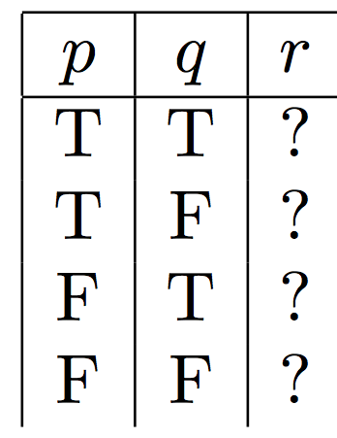

Slide 9
Break it Down like a James Brown Song:

Slide 10
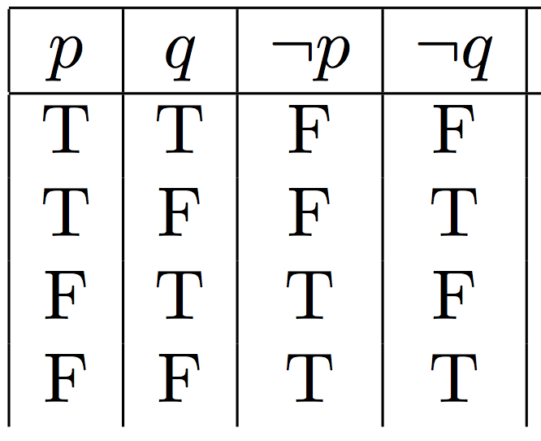

Slide 11
Break it Down like Justin Timberlake:

Slide 13
Break it Down like a Dubstep Song:

Slide 14
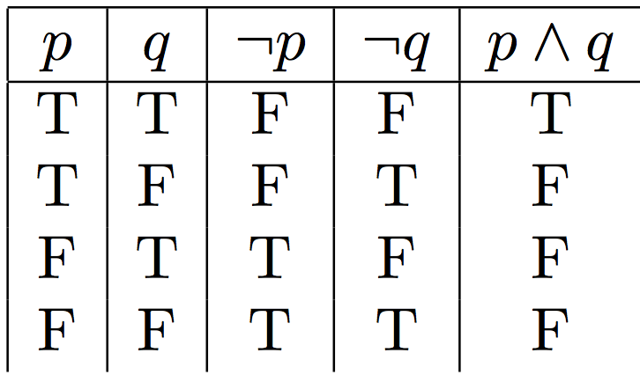

Slide 15
Break it down like a cardboard box:

Slide 16
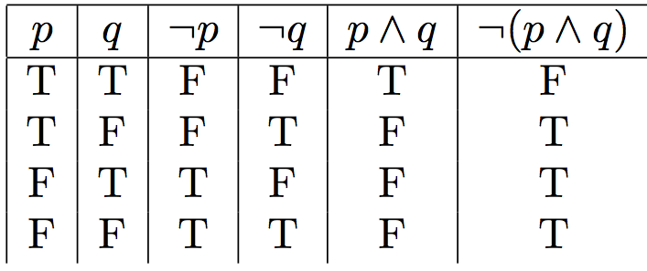
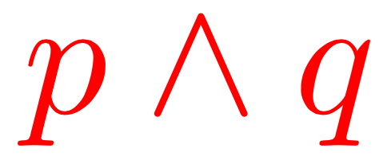
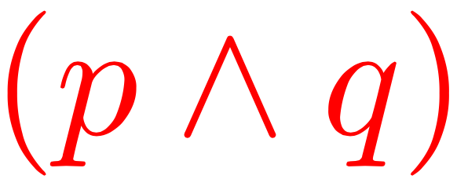

Slide 18
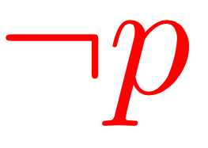
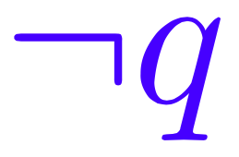
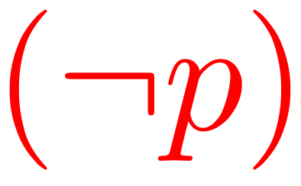
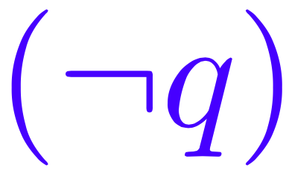

Slide 19
Logically Equivalent!!!

Slide 20
Double Negation Law:
(Negative times a Negative!)

Slide 21
Commutative Laws:
(Order Doesn’t Matter!)

Slide 22
Associativity Laws:
(Order Really Doesn’t Matter!)

Slide 23
Absorption Laws:

Slide 24
Distribution Laws:

Slide 25
Rob’s Law:

Slide 26
Basic
Rob’s Law

Slide 27
The Algebra of Logic:
Use the basic laws to show that:

Slide 28
The Algebra of Logic:
(Rob’s Law)
(Distribution Law)
(Rob’s Law)

Slide 29
The Algebra of Logic:
Use the basic laws to show that:

Slide 30
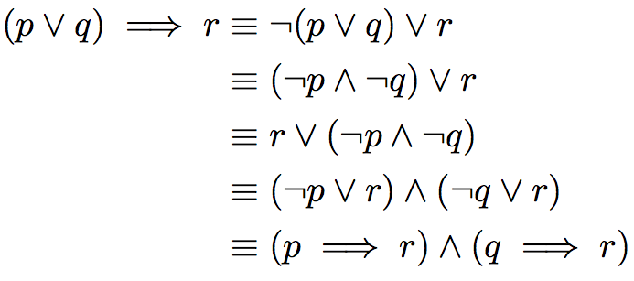
The Algebra of Logic:
(Rob’s Law)
(DeMorgan’s Law)
(Commutativity Law)
(Distribution and Commutativity Law)
(Rob’s Law)

Slide 31
The Algebra of Logic:
Use the basic laws to show that:
(Contrapositive)

Slide 32
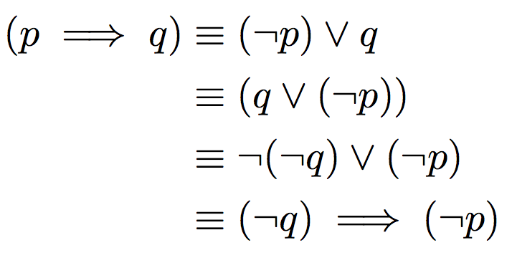
The Algebra of Logic:
(Rob’s Law)
(Commutativity Law)
(Double Negation Law)
(Rob’s Law)

Slide 33
The Algebra of Logic: (Group Work)
Use the basic laws to show that:
(SL)
(GR)
(HP)
(RC)

